Slide 1

Computer Architecture and Logic Design (CALD) Lecture 02
Engr.Ramsha Mashood
Sr.Lecturer
Department of Software Engineering
Bahria University Karachi Campus
Email: sorathhansrajani.bukc@bahria.edu.pk

Slide 2
Example
Examples It will be instructive to look at some real- world examples that illustrate the hierarchical structure of computers. Figure 1.3 is a photograph of the motherboard for a computer built around two Intel Quad- Core Xeon processor chips. Here, we mention the most important, in addition to the processor sockets:
■ PCI-Express slots for a high-end display adapter and for additional peripherals
■ Ethernet controller and Ethernet ports for network connections.
■ USB sockets for peripheral devices

Slide 3
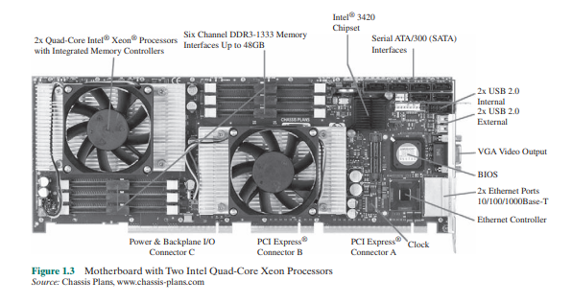

Slide 4
Von Neumann Architecture
Introduced by John Von Neumann in 1945.
The first generation electronic computer EDVAC (Electronic Discrete Variable Computer).
Also known as IAS computer.
Designed at the Princeton Institute for Advanced Studies.
Completed in 1952 and is the prototype of all subsequent general-purpose computers.

Slide 5
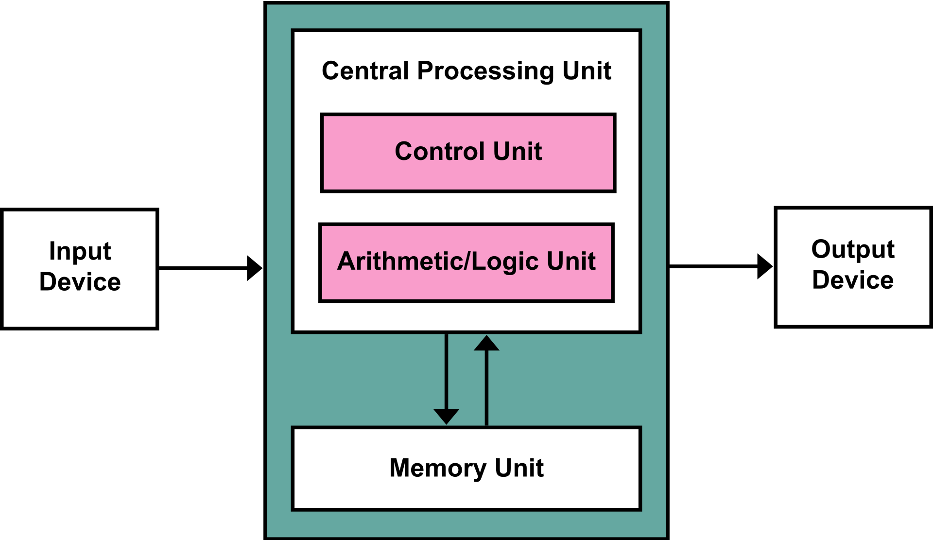
Von Neumann Architecture – Block Diagram

Slide 6
Von Neumann Architecture
Historically there have been 2 types of Computers:
Fixed Program Computers – Their function is very specific and they couldn’t be re-programmed, for example: Calculators.
Stored Program Computers – These can be programmed to carry out many different tasks, applications are stored on them.
Von Neumann Architecture is based on stored-program computer concept.
It consists of:
A main memory, which stores both data and instructions.
An Arithmetic and Logic Unit (ALU) capable of operating on binary data.
A control unit, which interprets the instructions in memory and causes them to be executed.
Input-Output (I/O) equipment operated by the control unit.

Slide 7
Von Neumann Architecture
Instruction and data are stored in same memory.
Three key concepts:
Data and instructions are stored in a single read-write memory.
The contents of this memory are addressable by location, without regard to the type of data contained there.
Execution occurs in a sequential fashion, from one instruction to the next.

Slide 8
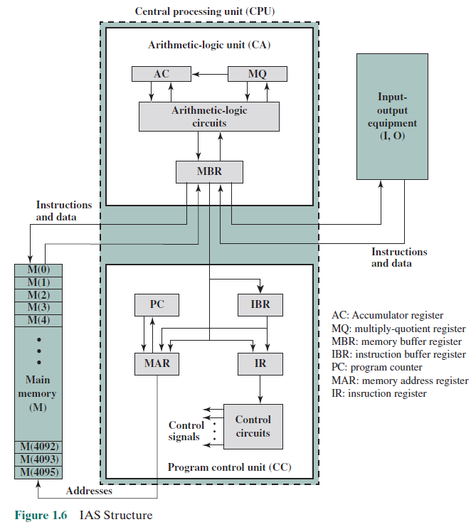

Slide 9
IAS Computer
Memory consists of 4096 storage locations, called words, of 40 bits each.
Instructions and data are stored in binary format.
Each number is represented by a sign bit and a 39-bit value.
A word may contain two 20-bit instructions.
Each instruction with 8-bit opcode (operation code) specifying the operation to be performed, and 12-bit address.

Slide 10
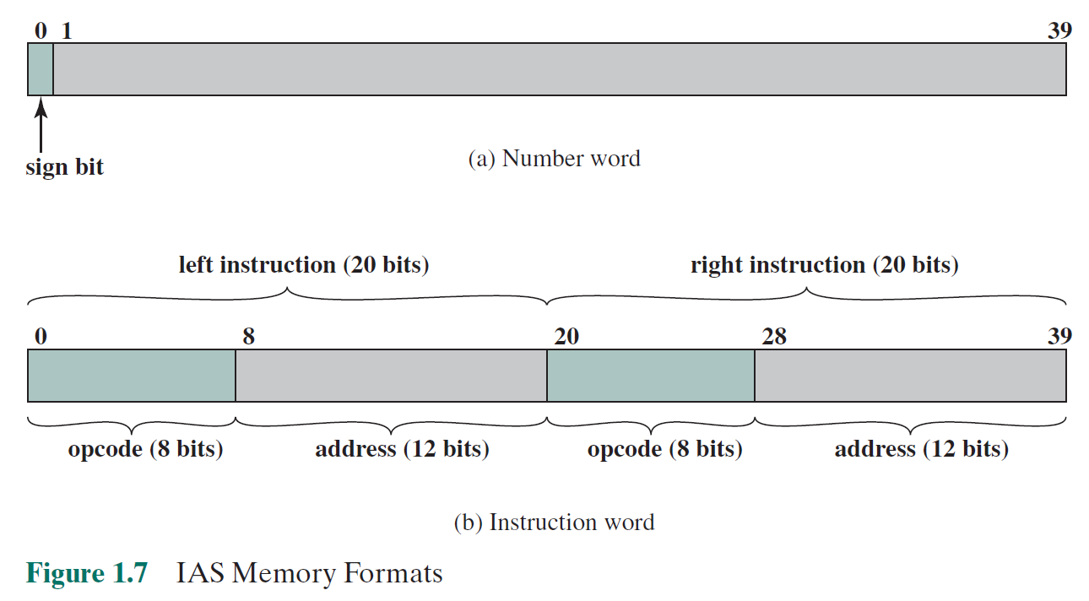
IAS Memory Formats

Slide 11
IAS Registers
Memory buffer register (MBR): Contains a word to be stored in memory or sent to the I/O unit or is used to receive a word from memory or from the I/O unit.
Memory address register (MAR): Specifies the address in memory of the word to be written from or read into the MBR.
Instruction register (IR): Contains the 8-bit opcode instruction being executed.
Instruction buffer register (IBR): Employed to hold temporarily the right-hand instruction from a word in memory.
Program counter (PC): Contains the address of the next instruction pair to be fetched from memory.
Accumulator (AC) and multiplier quotient (MQ): Employed to hold temporarily operands and results of ALU operations.

Slide 12
IAS Instruction Set
Total of 21 instructions, grouped in 5 categories as follows:
Data transfer: Move data between memory and ALU registers or between two ALU registers.
Unconditional branch: Normally, the control unit executes instructions in sequence from memory. This sequence can be changed by a branch instruction, which facilitates repetitive operations.
Conditional branch: The branch can be made dependent on a condition, thus allowing decision points.
Arithmetic: Operations performed by the ALU.
Address modify: Permits addresses to be computed in the ALU and then inserted into instructions stored in memory. This allows a program considerable addressing flexibility.

Slide 13
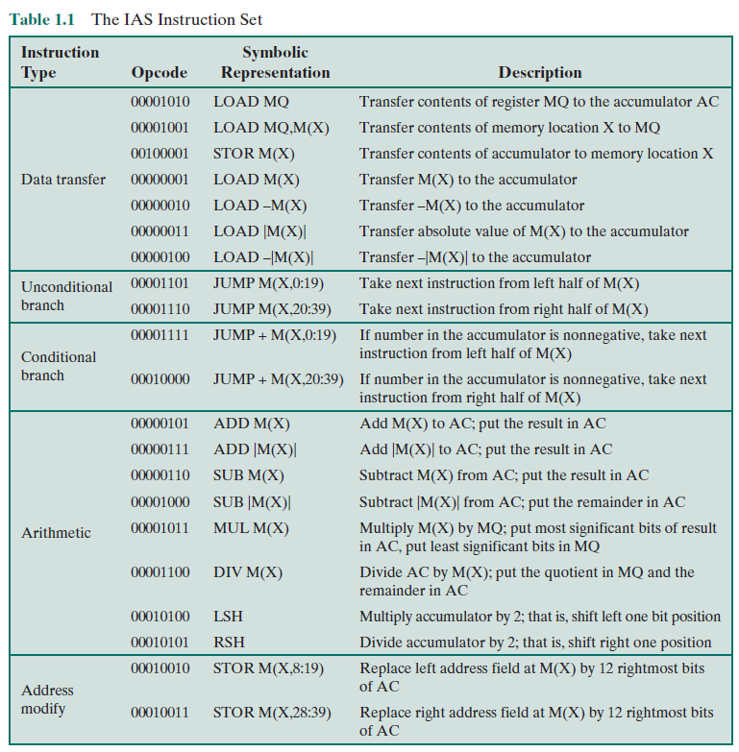

Slide 14
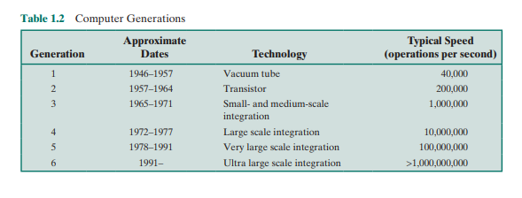
Computer Generations

Slide 15
microprocessors
A breakthrough was achieved in 1971, when Intel developed its 4004. The 4004 was the first chip to contain all of the components of a CPU on a single chip: The microprocessor was born.
The 4004 can add two 4-bit numbers and can multiply only by repeated addition. By today’s standards, the 4004 is hopelessly primitive, but it marked the beginning of a continuing evolution of microprocessor capability and power

Slide 16
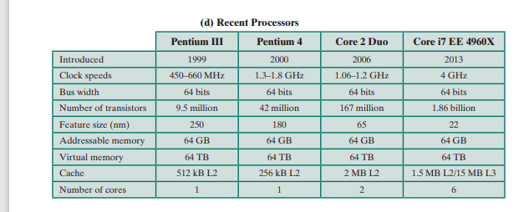
Evolution of Processors

Slide 17
Two Processor Families
Intel x86 and the ARM architectures
The current x86 offerings represent the results of decades of design effort on complex instruction set computers (CISCs).
The x86 incorporates the sophisticated design principles once found only on mainframes and supercomputers and serves as an excellent example of CISC design.
An alternative approach to processor design is the reduced instruction set computer (RISC).
The ARM architecture is used in a wide variety of embedded systems and is one of the most powerful and best-designed RISC-based systems on the market.

Slide 18
Microprocessor vs MicroController
Microcontrollers and microprocessors are different ways of organizing and optimizing a computing system based on a CPU.
While a microcontroller puts the CPU and all peripherals onto the same chip, a microprocessor houses a more powerful CPU on a single chip that connects to external peripherals.
Microcontrollers are optimized to perform a dedicated low-power application - ideal for embedded systems - while microprocessors are more useful for general computing applications that require more complex and versatile computing operations.

Slide 19
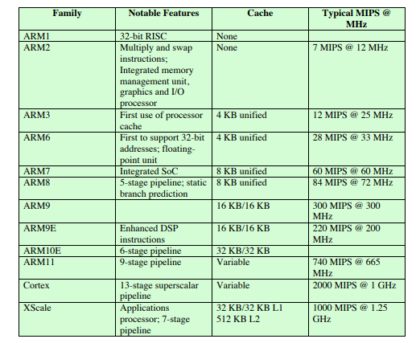
ARM Evolution
ARM is a family of RISC-based microprocessors and microcontrollers designed by ARM Holdings,

Slide 20
Cloud Computing
A model for enabling ubiquitous, convenient, on-demand network access to a shared pool of configurable computing resources (e.g., networks, servers, storage, applications, and services) that can be rapidly provisioned and released with minimal management effort or service provider interaction.

Slide 21
